Slide 2

1
7
Lesson 17
Solid Geometry III
Distance and Counting

Slide 3
Part 1
Perpendicularity of line and plane

Slide 4

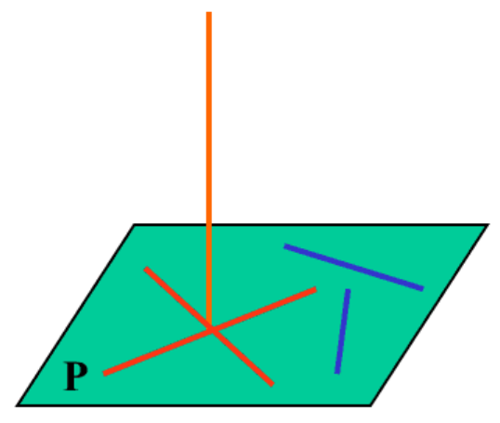
Lead in

Slide 5

Lead in

Slide 6

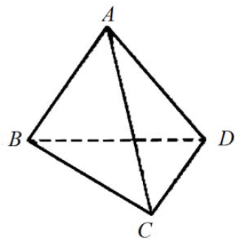
Example

Slide 7

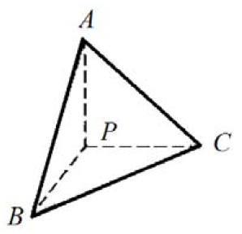
Example

Slide 8

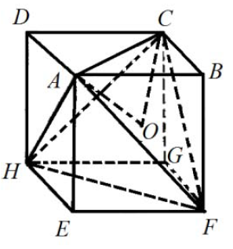
Example

Slide 9

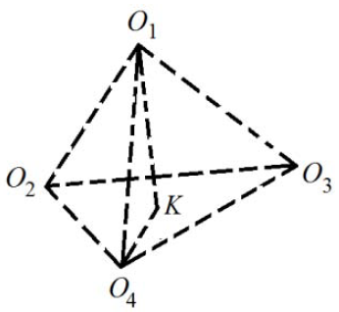
Example

Slide 10

Example

Slide 11

Example

Slide 12
Part 2
Three-Dimension Coordinate Plane

Slide 13
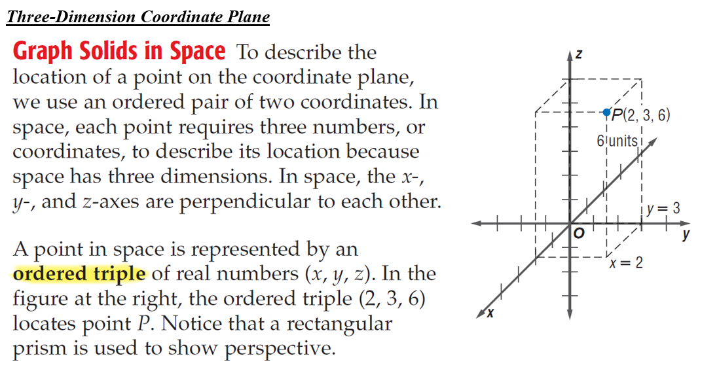
Lead in

Slide 14

Example

Slide 15
Part 3
Counting Based on Solid Geometric Features

Slide 16
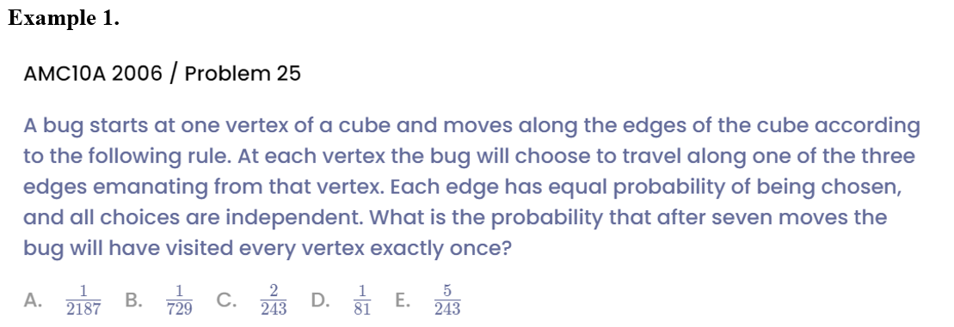
Example

Slide 17
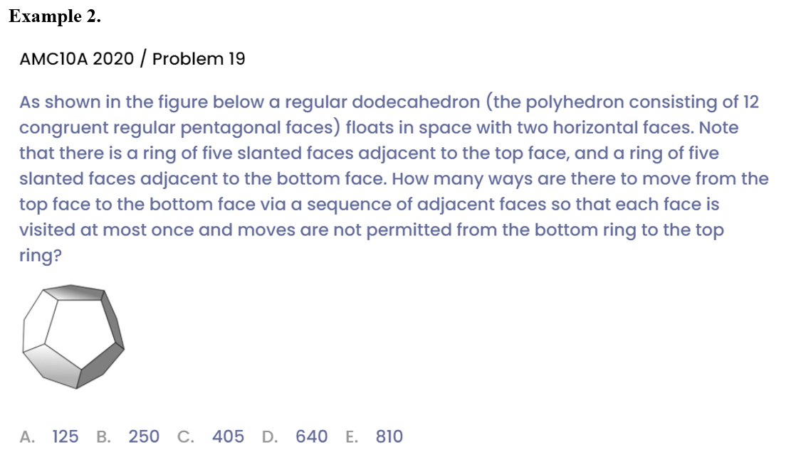
Example

Slide 18

Example

Slide 19
See You Next Time!

